Slide 1
2014
@kaccampbell
#futureux
#uxpa2014
Notes:
In 2024, the people will be represented by two separate, yet equally important groups: the ux professionals who create experiences and the legal system which creates and enforces laws to protect them against bad ux

Slide 2
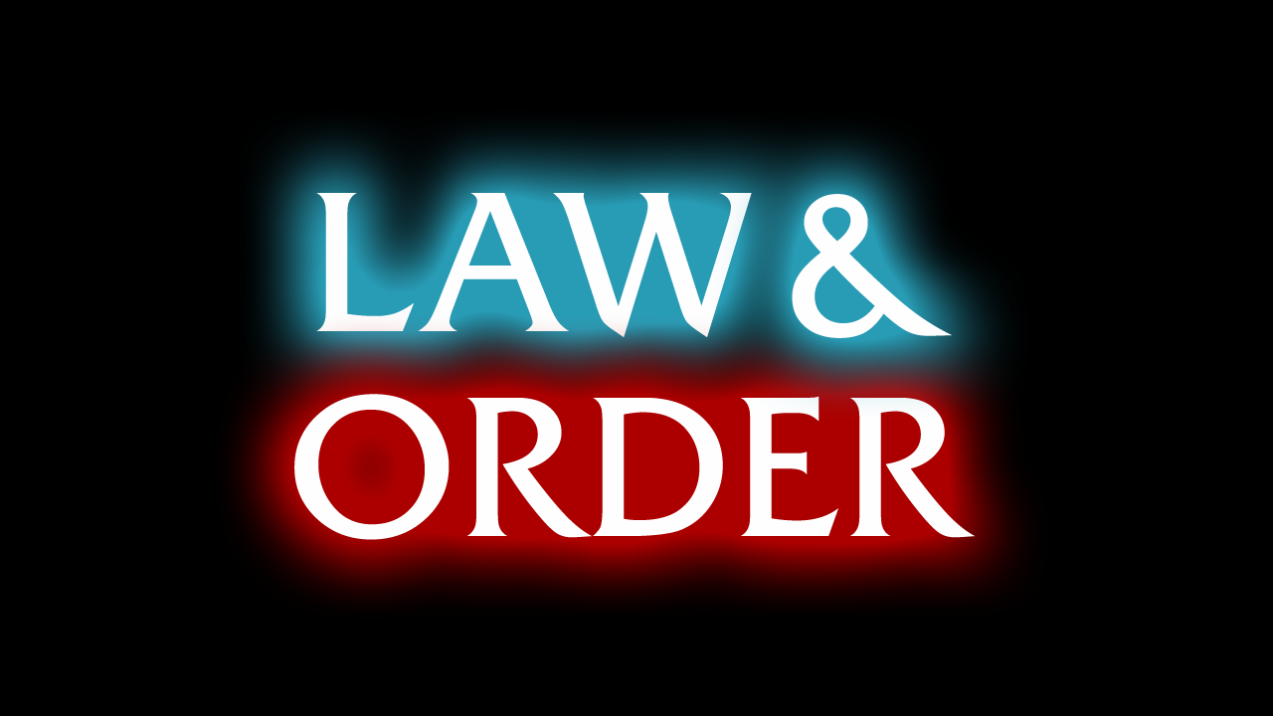
USER EXPERIENCE EDITION
2024
Notes:
At a gut level, we all know that some uxs are harmful to users. However, we’re only at the early

Slide 3
vs

Slide 4
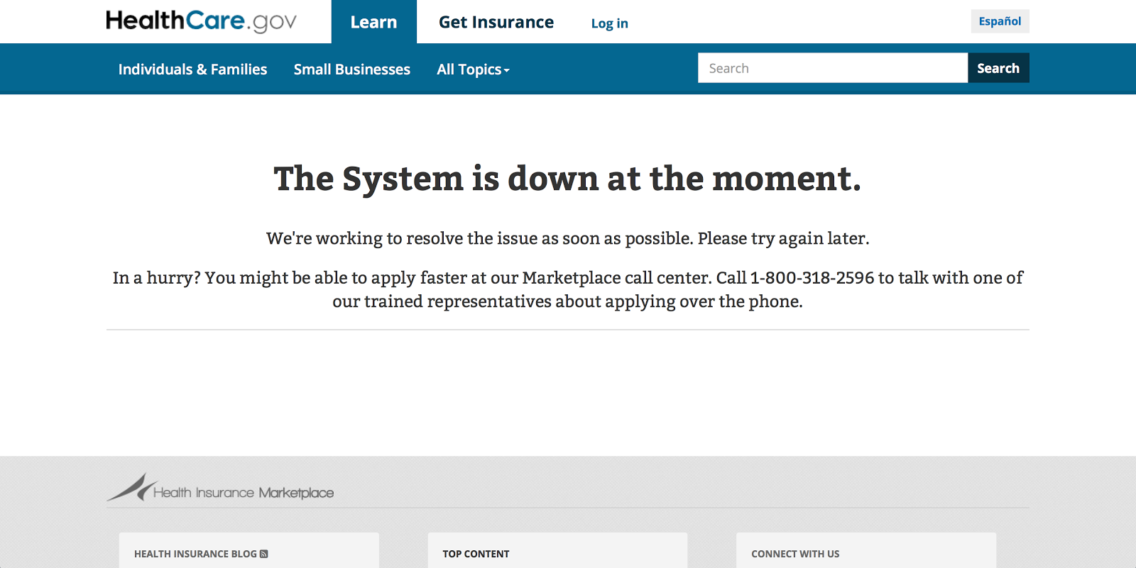

Slide 5
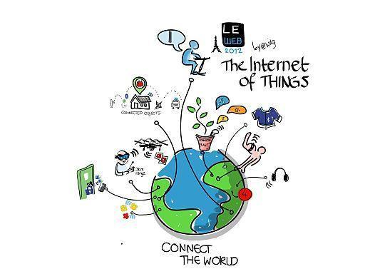
Notes:
In the future, even more entities will go digital

Slide 6
Notes:
Smart homes

Slide 7
`
Notes:
Smart vehicles

Slide 8
Notes:
Smart clothes and accessories

Slide 9
Notes:
Movies

Slide 10
We need “Smart” laws too.

Slide 12
Notes:
UX and the Law courses and specializations; hybrid degrees and certificates

Slide 13
Notes:
With increased technical skills and knowledge

Slide 14
CREATIVITY
Notes:
Initially, we will feel

Slide 15
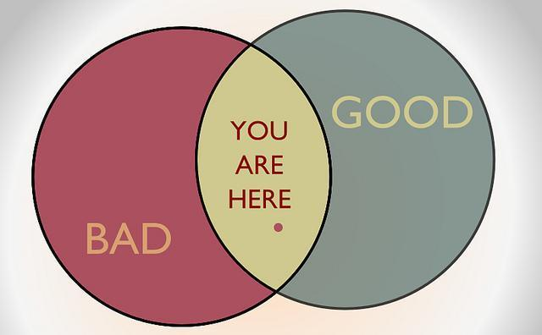
Notes:
Overall, we will see an increased focus on ethics

Slide 16
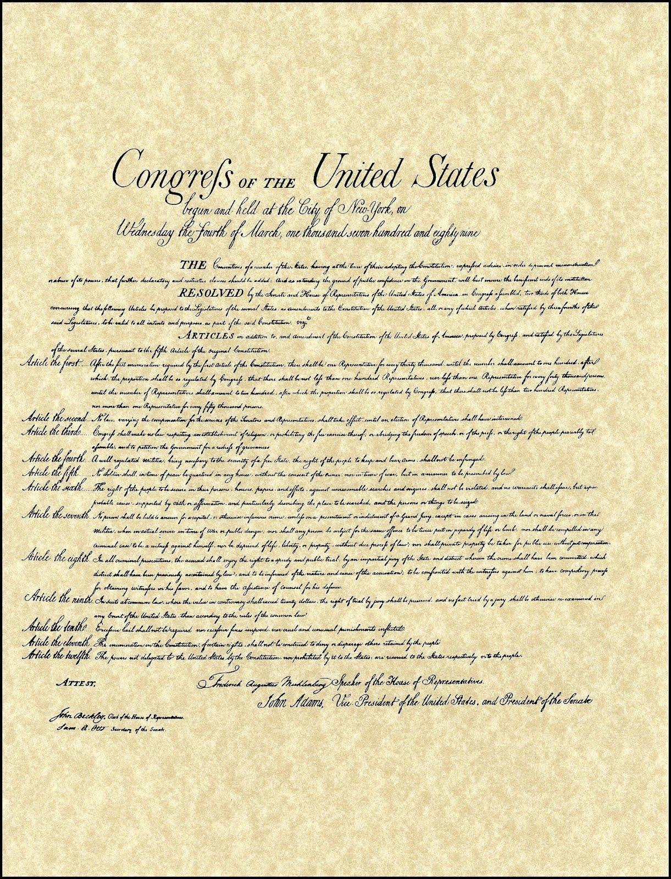
Notes:
We will see strong activism from users as well

Slide 17
Notes:
This will be a global movement

Slide 18
Good people do not need laws to tell them to act responsibly, while bad people will find a way around the laws. - Plato
Notes:
Good people don’t need laws to tell them to act responsibly; bad people will find a way around the laws

Slide 19
Notes:
These are signs of becoming more mainstream

Slide 20
KEEP CALM AND CARRY ON

